Slide 1

Hecla Mining Company NYSE: HL Target Price: $ 20 Recommendation: BUY/ hold

Slide 2
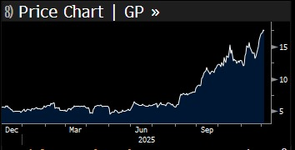
Company Overview
Founded in 1891, one of the oldest U.S. silver producers
Operational mines across Alaska, Idaho, Quebec
Revenue mix: Silver, Gold, Zinc, Lead
Focus on long-life assets with strong ESG compliance
Price Chart <DES>

Slide 3
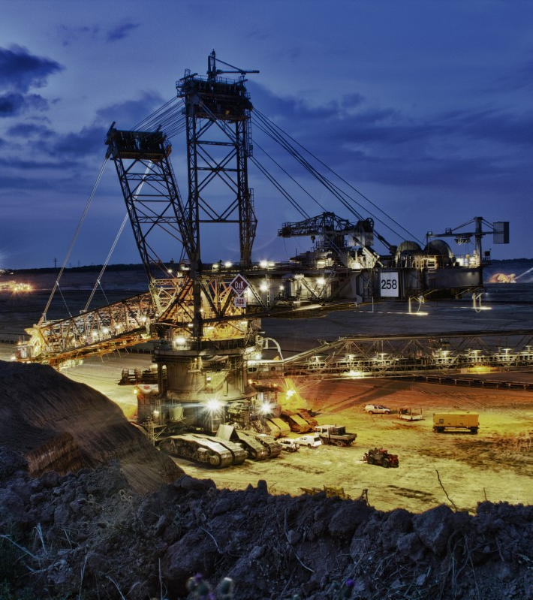
The Aha Moment
Data centers drive rising demand for silver and copper.
Significant holdings in SIL, SILJ, SLYP, GDXJ, GDEX
The Genesis Mission on the AI future.

Slide 4
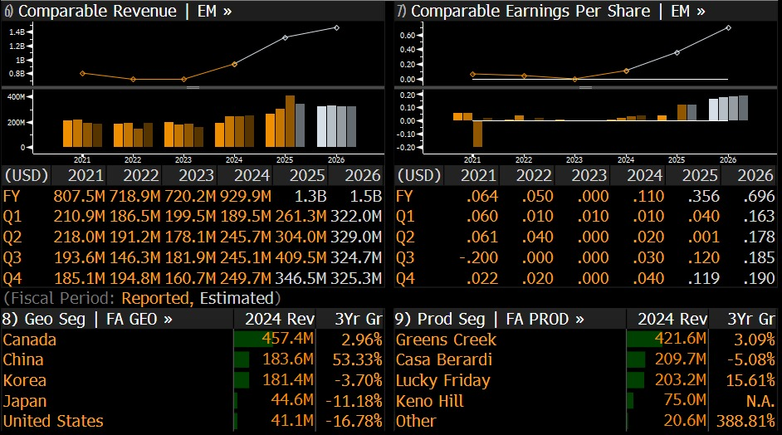
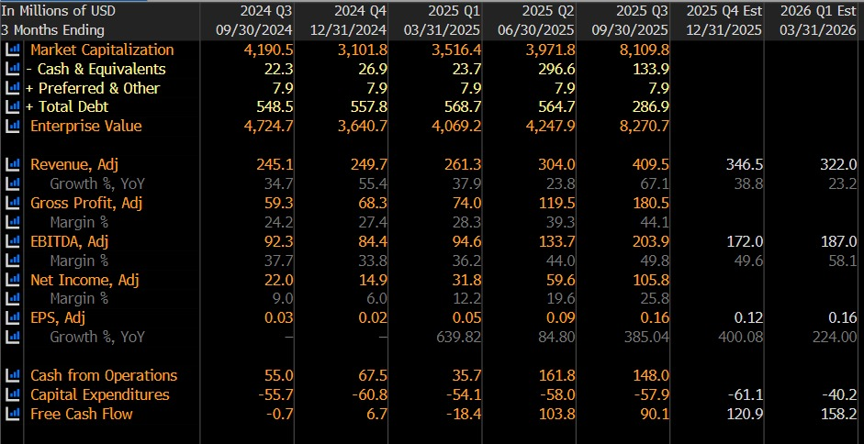
Financials
DES
The company seems to be emerging from a downturn into a period of strong Revenue Growth.
It seems to have significantly improved profitability.
These Metrics shows investor confidence as seen with the current surge in stock price
FA

Slide 5
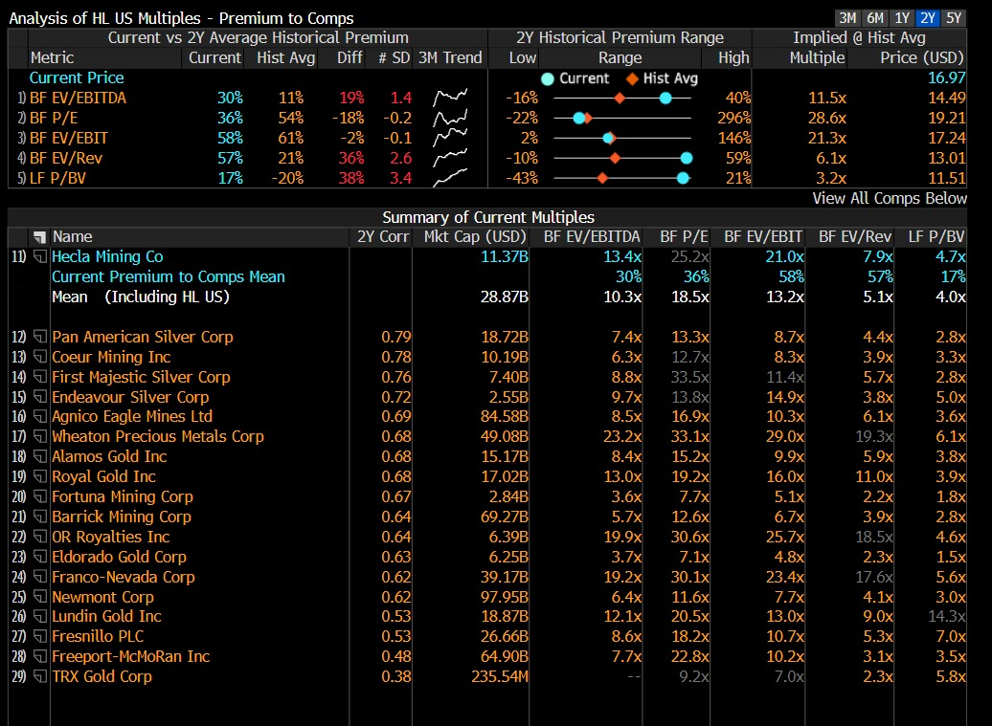
Peer comparison
Hecla Mining as a company commanding a significant valuation premium compared to its direct competitors, though this premium is not extreme across all metrics when viewed against its own historical trading range.
EQRV

Slide 6
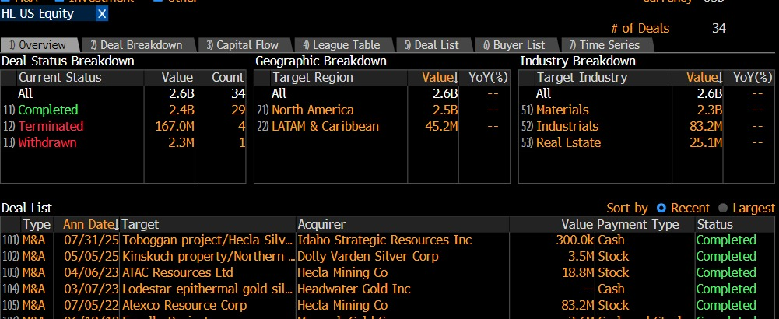
Investment Thesis
The current valuation says that the stock is overvalued.
The stock can normalize with new contracts from government on mining.
Genesis Mission can help here.
With these they can accelerate mining permits.
Hecla has a major share in Mining ETF and Silver ETF.
MA
Increase in the AI infrastructure demand can lead to increase in demand on silver.
With current policies and talks on shifting of the manufacturing of the AI chipset within the USA, Hecla seems to be in a great position.

Slide 7
Etf’S HELD BY Hecla Mining Co
SIL (Global X Silver Miners): 8.2% weight, 12.4M shares
SLV (iShares Silver Trust): Indirect, physical backing
GDX (VanEck Gold Miners): 2.1% weight, 3.2M shares
SILJ (Junior Silver Miners): 4.8% weight, 7.3M shares
TOTAL ETF OWNERSHIP: ~24% of float
FORCED BUYING: Every $100M into SIL = 450,000 HL shares
MONTHLY ETF FLOWS (Bloomberg FITR):
• SIL: +$287M (Nov 2024)
• SLV: +$845M (Oct-Nov 2024)
• GDX: +$1.2B (Q4 2024)
INSTITUTIONAL ACTIVITY:
• Vanguard: +2.1M shares (Q3)
• BlackRock: +1.8M shares (Q3)
• State Street: +1.2M shares (Q3)

Slide 8
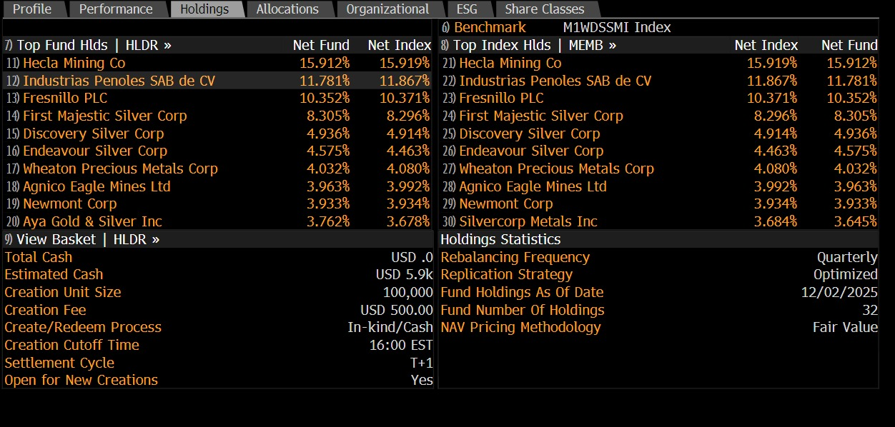
Scenario and Sensitivity analysis
Base case(Current Conditions)
Value/Share: $1.12-$ 4.11
Silver price remains unchanged
Still Overvalued
Bull Case( Catalyst Enhanced Scenario)
Silver prices are on the rise
Influx of money in the ETF markets i.e. both Normal and forced Buys
Increase in revenue by 38%
Due to high operation leverage and high silver prices the EBITDA margin is also on the rise
Potential Value: $15-18/share

Slide 9
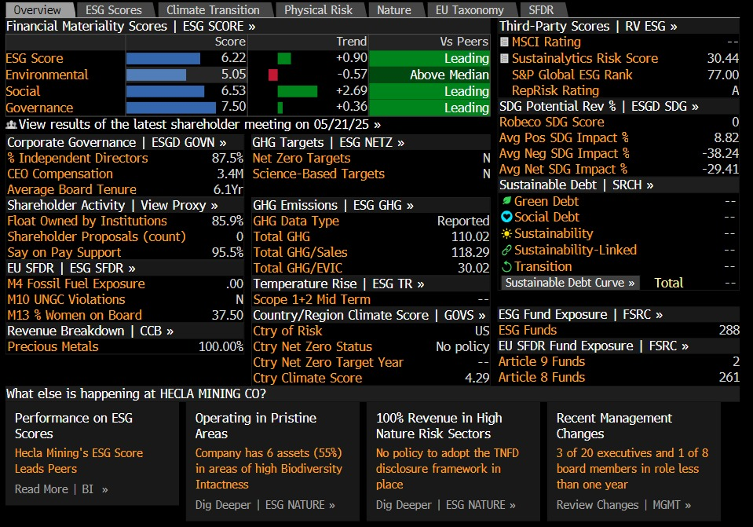
ESG
ESG
Strong governance & social scores, but significant environmental risks.
Overall ESG score is considered "Leading" among its competitor group.
Critical Gaps in climate strategy: No Net Zero target and No Science based targets has been set.
Hecla is a well-run company from a governance perspective but lacks a forward-looking, strategic plan to manage its material environmental and climate-related risks, which exposes it to future regulatory and physical threats.

Slide 10
Risks
Policy Implementations delays
Ai demand Materizes slower than expected
Competing Technologies
ETF flows

Slide 11

Thank you

